Slide 1


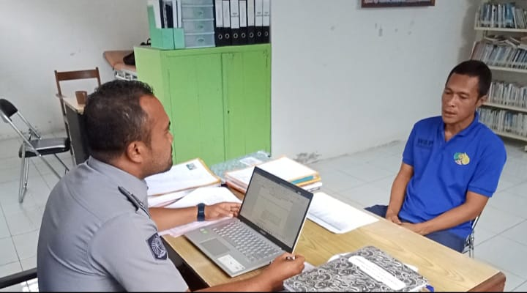
CORRECTIONAL ASSESSMENT ON CRIMINAL JUSTICE SYSTEM AND INDONESIA’S CORRECTIONALS
By :
Acik Veriati

Slide 2


Main Discussion
Overview of risk and need assessment instruments that have been developed by the Directorate General of Correctional
Development direction of risk and need assessment instrument based on the renewal of penal code, the law of Republic of Indonesia No. 1 In 2023 on Penal Code, the law of Republic of Indonesia No. 22 In 2022 on Corrections

Slide 3
The Law of Republic of Indonesia No. 22 In 2022 on Corrections
A significant renewal on accomplisment of correctional’s tasks

Slide 4
Risk and Need Assesment on The Law of Republic of Indonesia of 22 In 2022
Article 10 and Article 13 section (2)
Giving right of Prisoners and foster children (Remission, Assimilation, leave to visit family (CMK), conditional leave (CB), on leave before being released (CMB), Parole (PB) and other rights. Prisoner and foster child must qualify the qualifications:
1. Well behave
2. Being active on joining fostering programs
3. Has shown the reduction of risk level
Article 20;29;36;49 section (4)
The placement of prisoners, child must considered the result of risk and need assessment which explained on social research.
Article 54
Assesment becomes a base recommendation for either program service or exclusive fostering for high risk prisoners:
1. Placement
2. Program service or fostering program

Slide 5
When Assesment Need to Be Done ?
RUTAN
LAPAS
BAPAS
STATE OF PRISON
CORRECTIONS SERVICE
CORRECTIONAL HALL
Reception of Custody
Service and Classification Assesment of Custody
- Program Service/Nursing Care Program
RECEPTION OF PRISONERS/ FOSTERING CHILD
ISPN and RRI criminogenic
Placement/Beginning Assesment
Beggining fostering program
RECEPTION OF ADULT OR CHILD CLIENT
RRI KRIMINOGENIK
Program Pembimbingan Awal
v
RE-ASESSMENT
RRI CRIMINOGENIC
Advanced program of supervising
Advanced program of supervising (Voluntary)
PRISONERS (INCRAHT)
ISPN Assesment
- Placement at Correctional service based on risk classification
ASESMEN SPPN
v
SPPN ASSESMENT
RE-ASSESSMENT
ISPN and RRI CRIMINOGENIC
Advanced program of fostering
Assimilation and or integration
SOSIAL RESEARCH

Slide 6
INSTRUMEN ASESMEN RISIKO DAN KEBUTUHAN
DALAM PEMASYARAKATAN INDONESIA
RISK AND NEED ASSESSMENT INSTRUMENT ON INDONESIA’S CORRECTIONAL
1. RESIDIVISME RISK INDONESIA (RRI) AND CRIMINOGENIC NEEDS
Expanded in 2009 (Partnership with NSW Corrective Services)
An Adaptation from LSI-R Instrument
basic concept: What’s Work Principles dan Criminogenics Needs
Assesment’s Variabel: behaviour/ risky condition of repetition of criminal acts and criminogenik needs (past and present)
Objective : To identify the risk of repetition of criminal acts dan criminogenic’s factor
Implemented on Inmate reception/ correctional client for recommendation of both fostering and supervising program.
Reasessment every year or one time in 6 months
Revised in 2021, become RRI and criminogenic needs v02 (Partnership with UNODC- Kepdirjenpas No. PAS-31.OT.02.02 Tahun 2021.)
Advantages : compherhensive assesment both past and present’ behaviour, becoming scientific concept and a detail assessment
Disadvantages: Needing comprehension and good competency to do an assessment, static approach factor on RRI Instrument.

Slide 7
2. SERVICE ASSESMENT AND CUSTODY CLASSIFICATION
Expanded In 2018 - Kepdirjenpas No : PAS-41.OT.02.02 Tahun 2018
Basic Concept : Service standard and custody classification
Assessment’s variabel : custody’s background (private life, law process, drug abuse, mental health, health record)
Objective : To identify the need of custody service and security classification (kinds of criminal acts and detention status)
Implemented on the reception of custody
Advantages: Comprehensive assessment and detailed condition about custody (psychological and medical)
Disadvantages : need an exclusive competency to do an assessment (psychological and medical), too many main assessment and too complex, not well socialized

Slide 8
3. RISK AND NEED ASSESSMENT AND CHILDREN CRIMINOGENIC’S FACTOR
Expanded in 2019(Partnership with Center for Detention Studies )_ Kepdirjenpas PAS-120.PK.01.04.03 Tahun 2019
An Adaptation from RRI Criminogenic Instrument and Criminogenic Needs (Adulit)
Basic Concept: What’s Work Principles dan Criminogenics Needs
Assesment’s Variabel: behaviour/ risky condition of repetition of criminal acts and criminogenic needs (past and present)
Objectives : To identify the risk of repetition of criminal acts dan criminogenic’s factor on Children
Implemented on foster children or children client’ on the reception as a recommendation for both fostering and supervising programs.
Reasessment every year or one time in 6 months
Advantages : compherhensive assessment both past and present’ behaviour, a scientific concept and a detail guideline of assessment.
Disadvantages: Need a whole comprehension and good competency to do assessment, the guideline of assessment is not detailed, lack of sosialization, there is a main evaluation still misstyping and need to be revised.

Slide 9
4. SCREENING INSTRUMENT FOR PRISONERS PLACEMENT (ISPN)
Expanded in 2019 (Partnership with Center for Detention Studies )_ Kepdirjenpas PAS-58.OT.02.02 Tahun 2019;
Basic Concept : Handbook on the Management of High - Risk Prisoners
Objective : To identify security risk, safety, stability and corrections
Assessment’s Variabel: Behavioural story and Prisoners’ life potency which related to security aspect, safety, stability and corrections, kinds of criminal act and duration of the sentence.
Implemented on transformation of status from custody to prisoners, prisoner’s inception and transferring prisoners.
Reasessment every 6 months
Nowadays, it is used as an assessment instrument to appraisal the degradation of risk level (Article 10 the Law of Republic Indonesia of 22 in 2022 on Corrections)
Advantages: simple assesment process , has isolated well, detailed assessment guideline
Disadvantages : Require complex supporting data, focusing on aspects of security and order.

Slide 10
5. INSTRUMENT FOR THE DEVELOPMENT OF HIGH RISK PRISONERS IN THE TERRORISM CATEGORY (RESPEK)
Expanded in 2019 (Partnership with dengan Center for Detention Studies )_ Kepdirjenpas PAS-251.PK.01.02.02 Tahun 2019;
AAn Adaptation from RRI Instrument and Criminogenic needs also for terrorism prisoners (VERA)
Objective : To identify fostering needs for terrorism prisoners
Assesment’s Variabel : beliefs, ideology, social, family relationship,procriminal attitudes and attitudes towards the Republic of Indonesia
Implemented on the reception of prisoners for recommendation for development and mentoring programs for prisoner in terrorism cases.
Asssesment’s period 6, 9 and 12 months.
Advantages : Specific Assesment for prisoners in terrorism cases, detailed guideline assesment
Disadvantages : Needing a complex supporting data, not accompanied by instrument which measure repetition risk level or safety risk

Slide 11
6. INSTRUMENTS FOR THE PRISONER’S DEVELOPMENT ASSESSMENT SYSTEM (SPPN)
Expanded in 2019 (Partnership withCenter for Detention Studies ) ;
An evidence based pratice approach in assessing of fostering prisoners
Objective : To identify prisoners’ respone on receiving fostering program through observation on daily behaviour
Assesment’s variabel : personality fostering assessment, independence fostering assessment, behaviour and mental condition.
Assesment period : one time in a month
Advantages : Assessing prisoners’ behavior directly based on their active participation in coaching, simple and easy for officers to do
Disadvantages : Assessing visible behavior- vulnerable to manipulative, require discipline officer to record, obser

Slide 12
Need for Development of Assesment Instruments
Reviewing and developing risk and need assessment instrument.
Assesment Instrument is suitable to measure the degradation of risk level (Article 10 the Law of Republic of Indonesia of 22 in 2022 on Corrections)
Assesment Instrument for child suspect and Adult (the Law of Republic of Indonesia of 11 In 2012 on SPPA and the renewal of penal code).
Specific Assesment Instrument based needs (kinds of criminal act, gender, age group, etc)

Slide 13
Pick manggo Get Five,
Wash hand So Clean
My presentation is not long
That is all thank you

